Slide 1
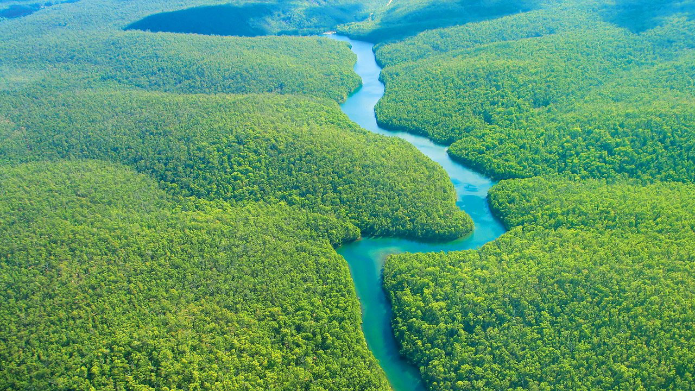
Deforestation
&
Policy in Brazil
Rayna Benzeev
Travis Williams
Isaac Bukoski

Slide 2
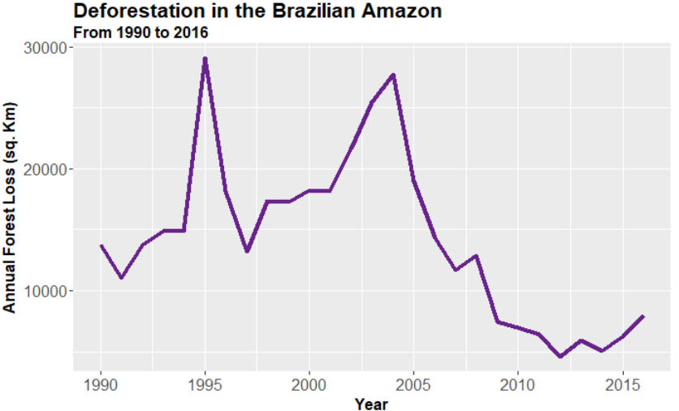
Background
Tropical deforestation
Threatens biodiversity and ecosystem services
GHG emissions
Main drivers of deforestation
Cattle ranching
Soybean production
Politics
Data is from: https://rainforests.mongabay.com/amazon/deforestation_calculations.html

Slide 3

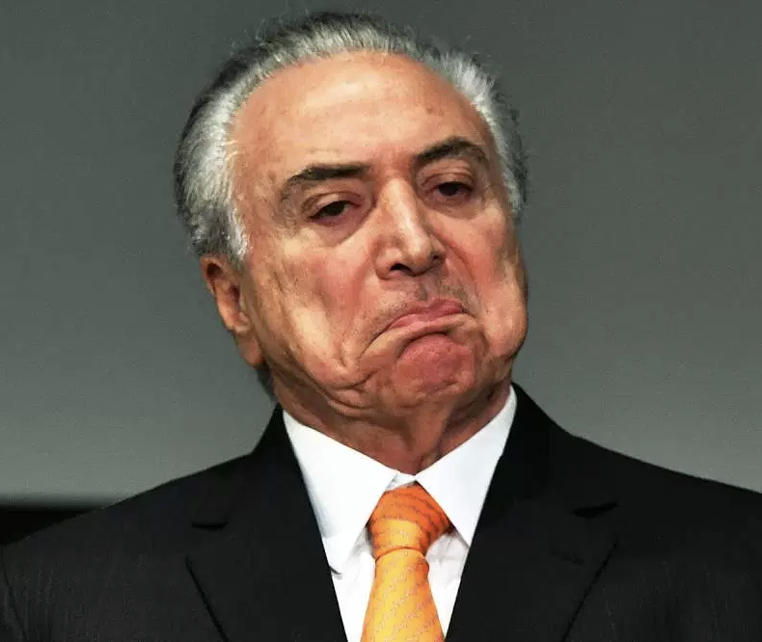
Shift in governance
August 16th, 2016 - President Dilma Rousseff ousted in political coup
Michel Temer, a pro-beef president, takes power
Notes:
JBS is the world’s largest meat producer - named after Jose Batista Sobrinho’s initials in 1953
The beef caucus is a group of legislators that support the cattle industry in Brazil
Michel Temer is considered a pro-beef president
Upon taking power he has:
Cut forest protection funding:
Slashing the environment ministry’s budget by 40%
Cutting the National Indian Foundation budge tby the same amount
Worked to delegitimize indigenous people’s land rights
Worked to reduce protections in national preservation land and parks
Sanctioned a law that pardons illegal land grabs
Put Osmar Serraglio, a prominent member of the beef caucus, in charge of the ministry of justice

Slide 4

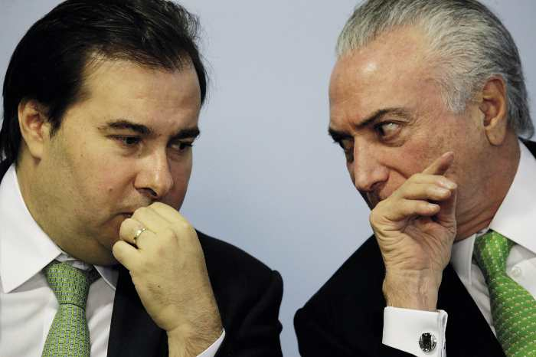
Michel Temer and his cows
Upon taking power he has:
Cut forest protection funding
Deligitimized indigenous peoples right to land
Reduced protection of national parks
Sanctioned laws pardoning illegal land grabs
All of this effort is, largely, to cater to the beef industry
Notes:
Is it even possible to correlate environmental responses to particular policy changes? Nature is an incredibly complex system and governance is doubly so; any change in the environment is due to a suite of interacting factors, and any change in policy creates a cascading ripple of effects through social, economic, and environmental spheres of life. Fortunately, an unfortunate event in Brazil has lead to a significant clustering of drastic policy shifts that might make this sort of signal more distinguishable from the noise in the ecological = system of the Amazon.

Slide 5
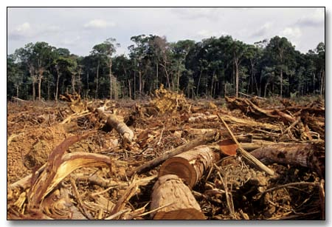
Research Directions
Can we detect changes in deforestation rates after Michel Temer takes office?
If so, can we quantify and compare these changes between GFW and Earth Explorer sources?
Notes:
Can environmental responses to policy be detected in satellite imagery?

Slide 6
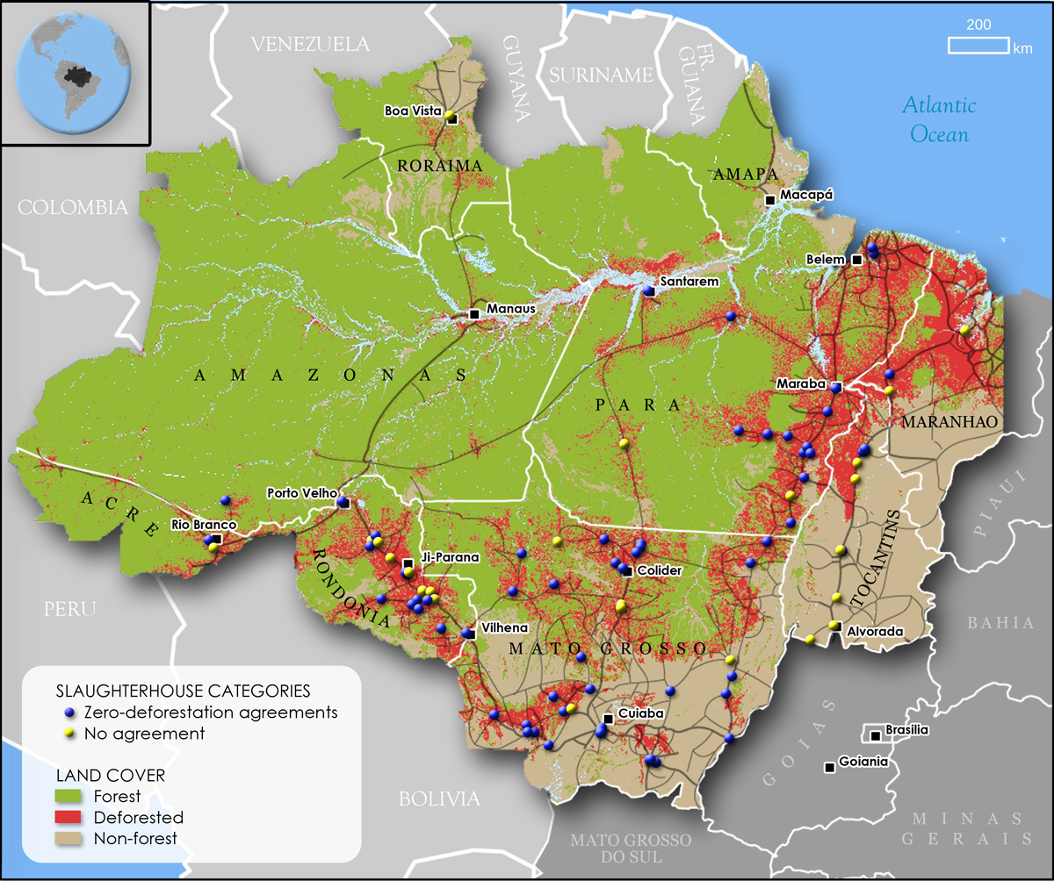
Methods
Study site: Southern section of Pará state, Brazil
Satellite data sourced from:
Earth Explorer - Landsat 8 OLI imagery
Global Forest Watch (GFW)
Notes:
Para state has the largest cattle herd within the brazilian amazon and the region is dominated by cattle production
Para accounted for 40% of amazonian deforestation over the last decade
Global Forest Watch (GFW) is an open-source web application to monitor global forests in near real-time. GFW is an initiative of the World Resources Institute (WRI), with partners including Google, USAID, the University of Maryland (UMD), Esri, and many other academic, non-profit, public, and private organizations.

Slide 8
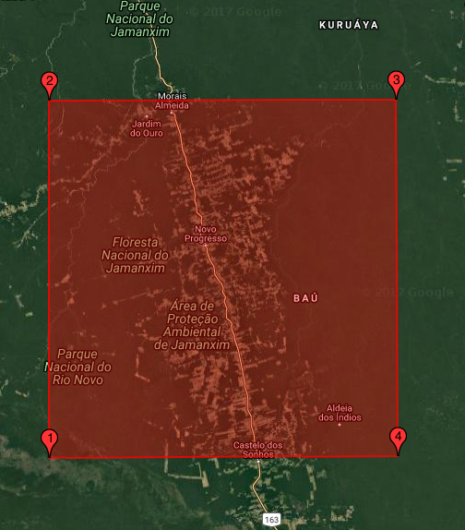
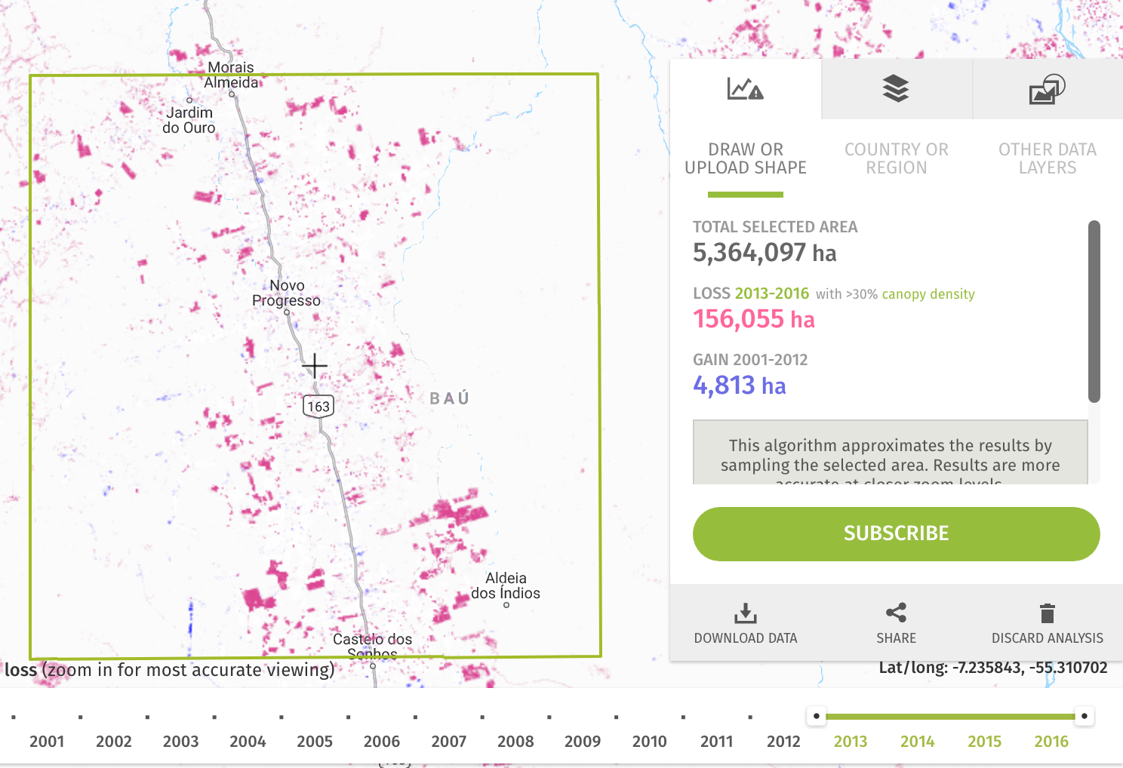
Global Forest Watch / Landsat 8 OLI

Slide 9
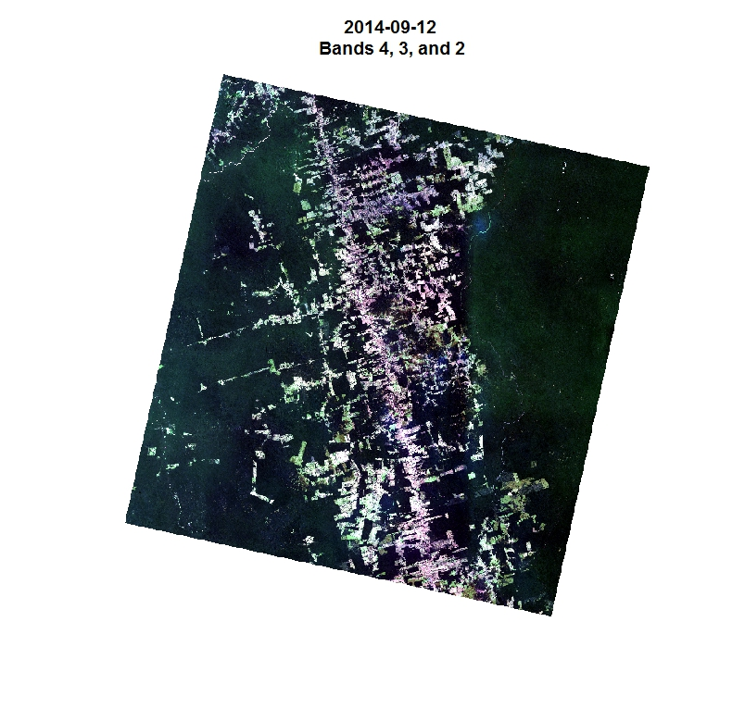
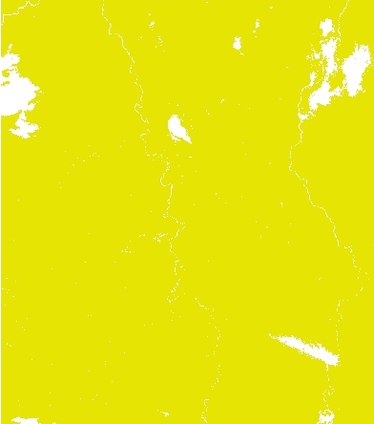
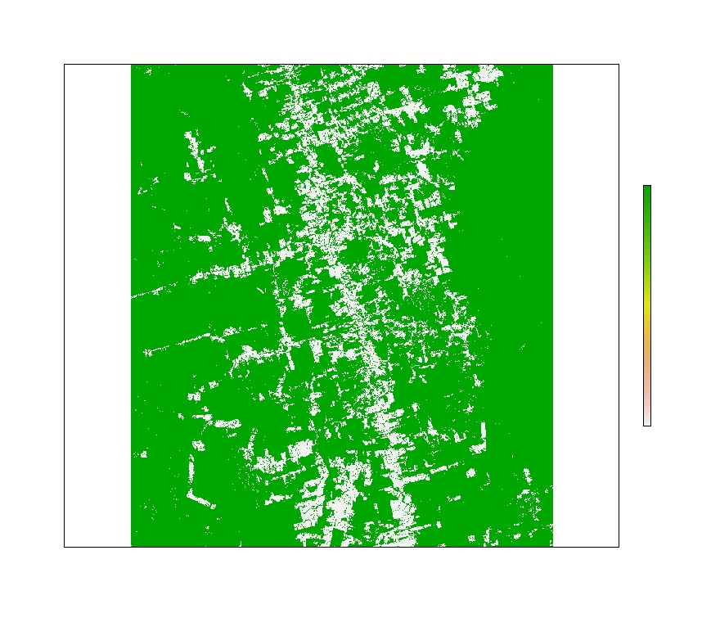
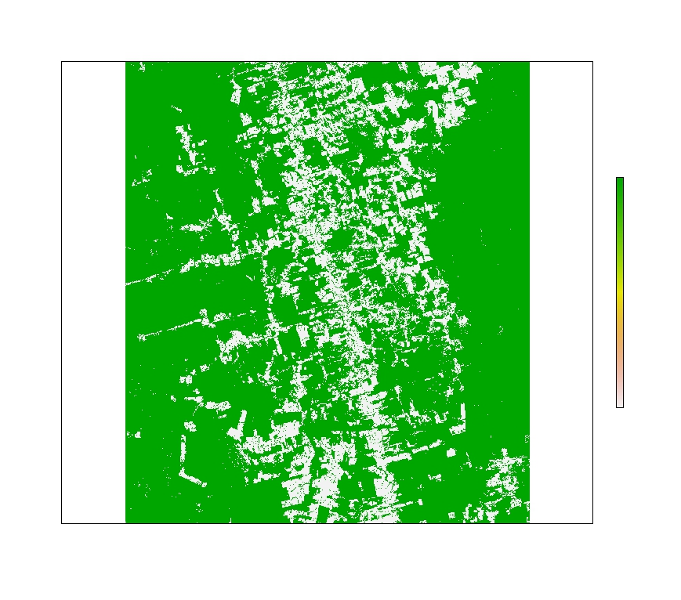
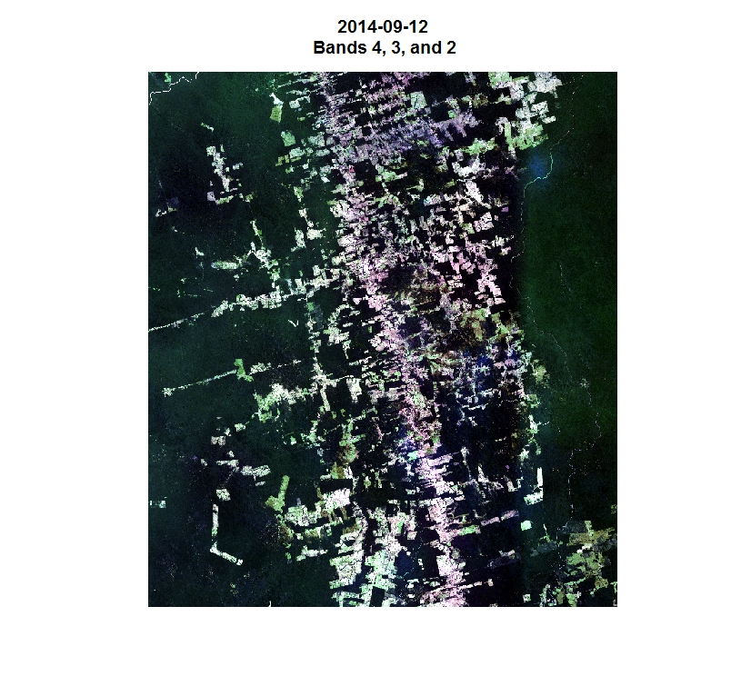
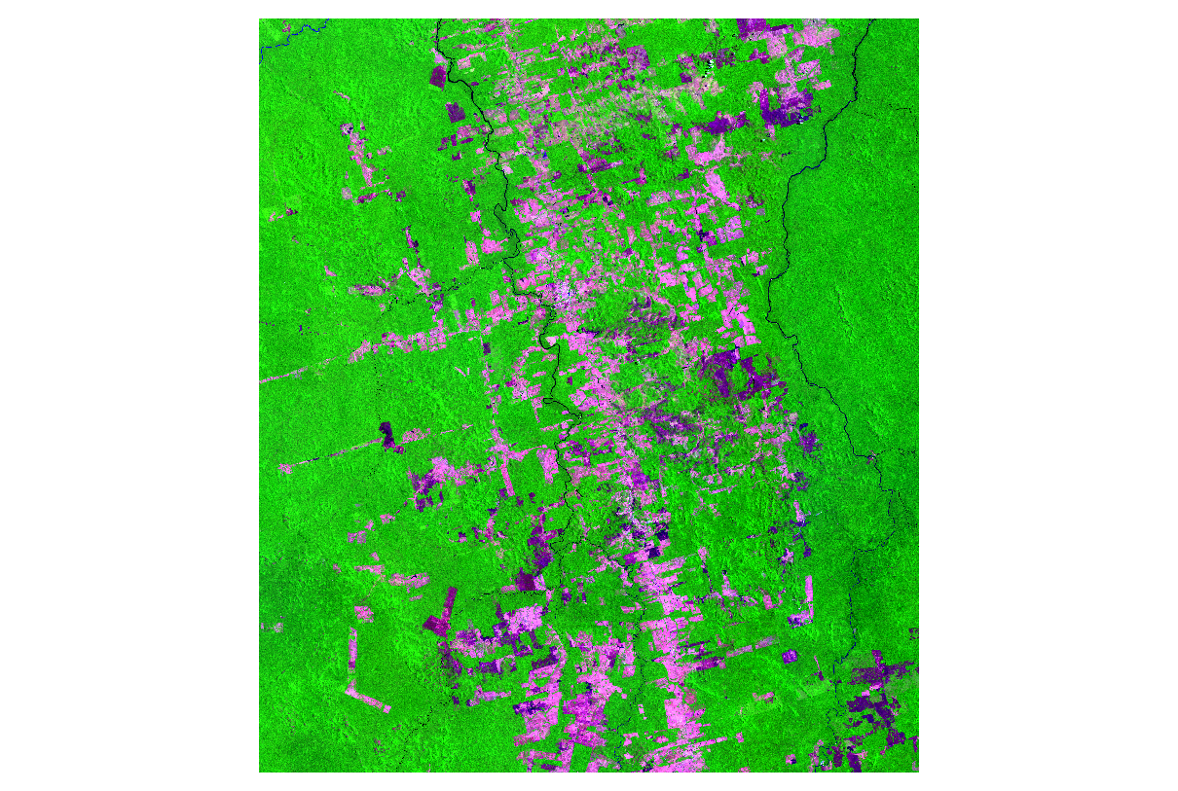
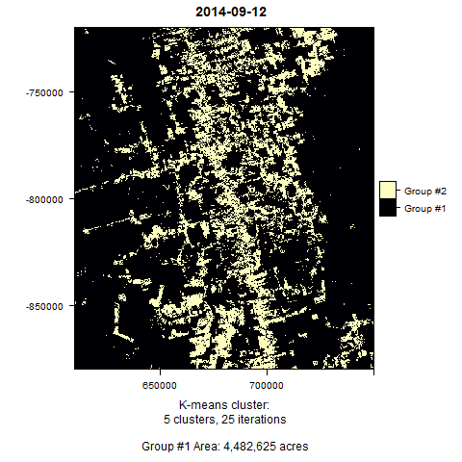
Process
Apply cloud mask
Apply Last year’s mask
and count pixels!
Use as Mask for Next Year
Original
Crop & Shift
Bands 6, 5 & 4
K-Means
Notes:
Increase in deforestation in the past year

Slide 10
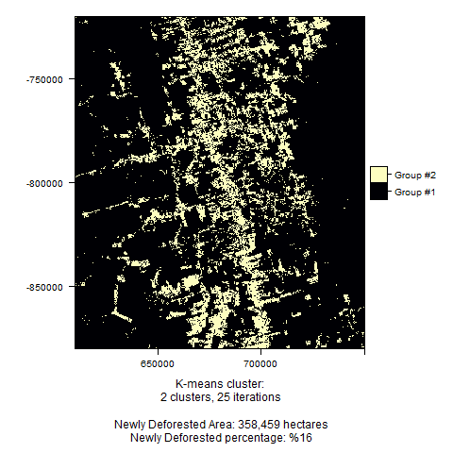
K-Means
2013
2013

Slide 11
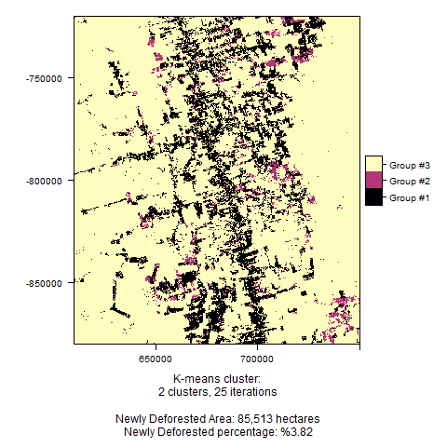
K-Means
2014
2014

Slide 12
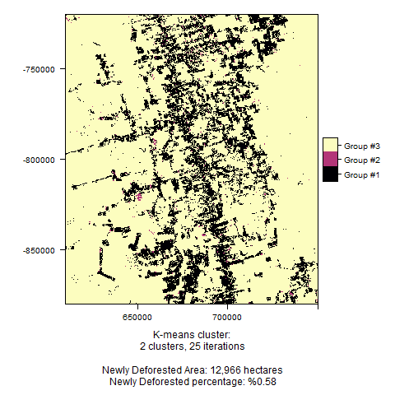
K-Means
2015
2015

Slide 13
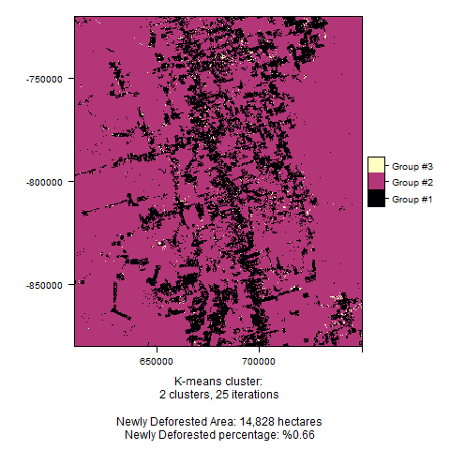
K-Means
2016
2016

Slide 14
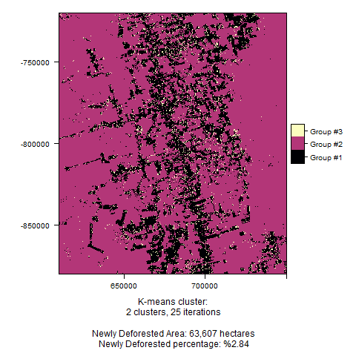
K-Means
2017
2017
Notes:
Increase in deforestation in the past year

Slide 15
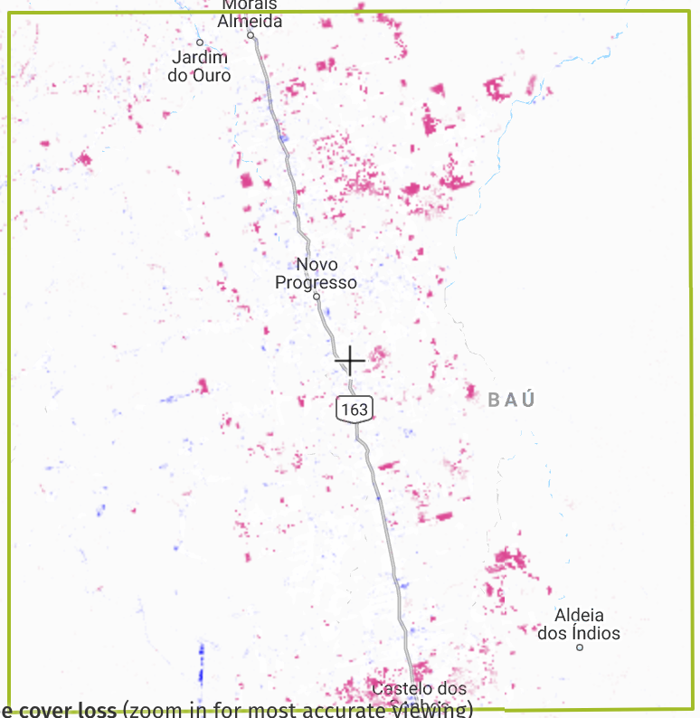
GFW
2012
Notes:
Total tree cover vs. new deforested area

Slide 16
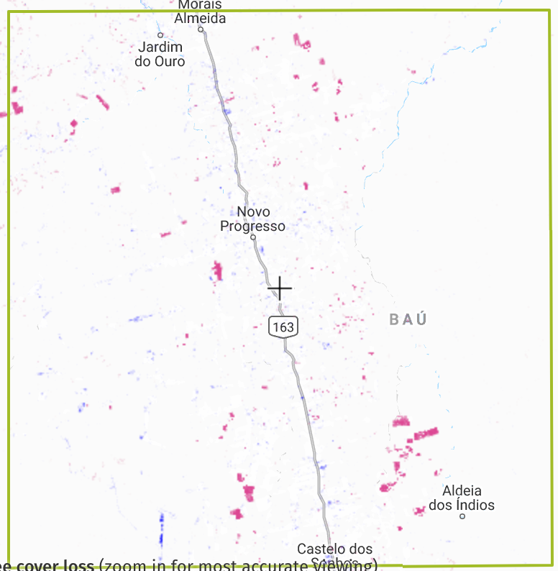
GFW
2013

Slide 17
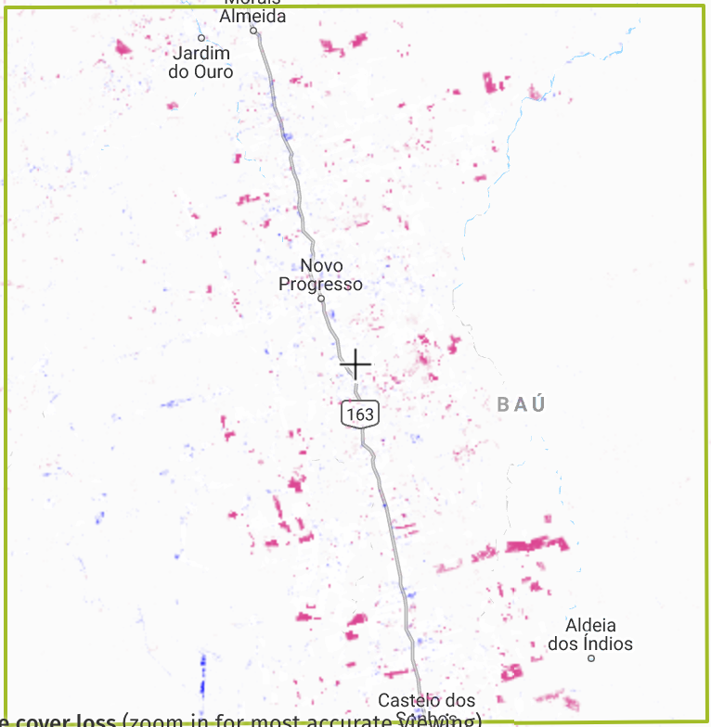
GFW
2014

Slide 18
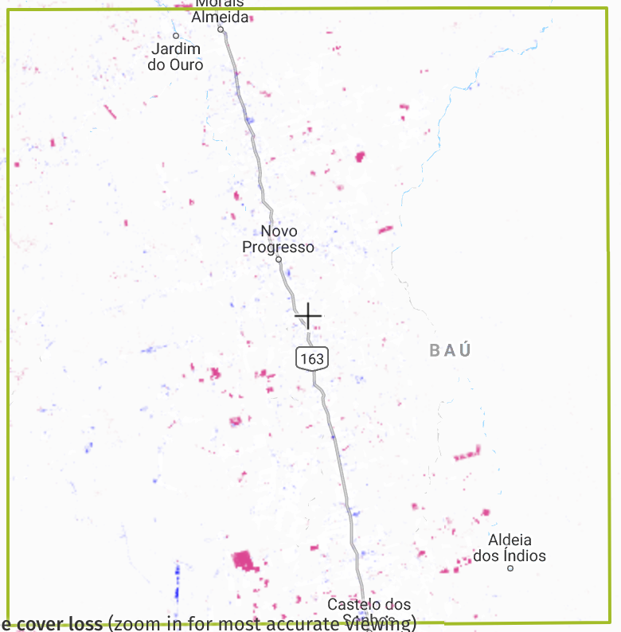
GFW
2015

Slide 19
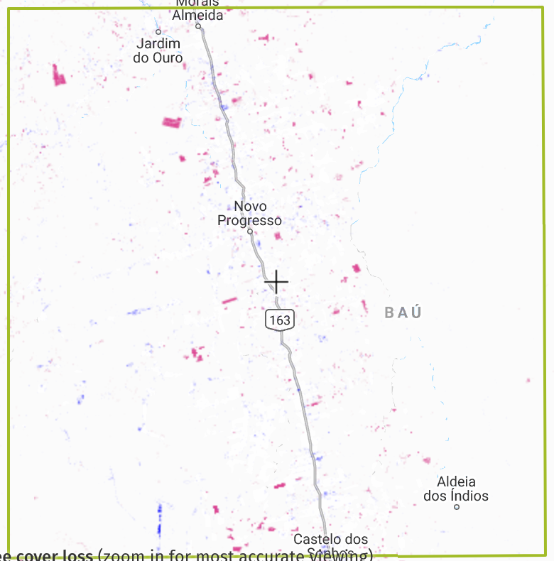
GFW
2016

Slide 20
Results
Year | Global Forest Watch Hectares ( % total area loss) | Landsat 8 OLI Cluster 6,5,4 Composite Hectares (% total area loss)
2012 | 1.51 | NA
2013 | 0.63 | NA
2014 | 1.07 | 3.82*
2015 | 0.58 | 0.57
2016 | 0.62 | 0.65
2017 | NA | 2.67
* Uncalibrated year
Notes:
47473
18566
34120
14840
18789

Slide 21
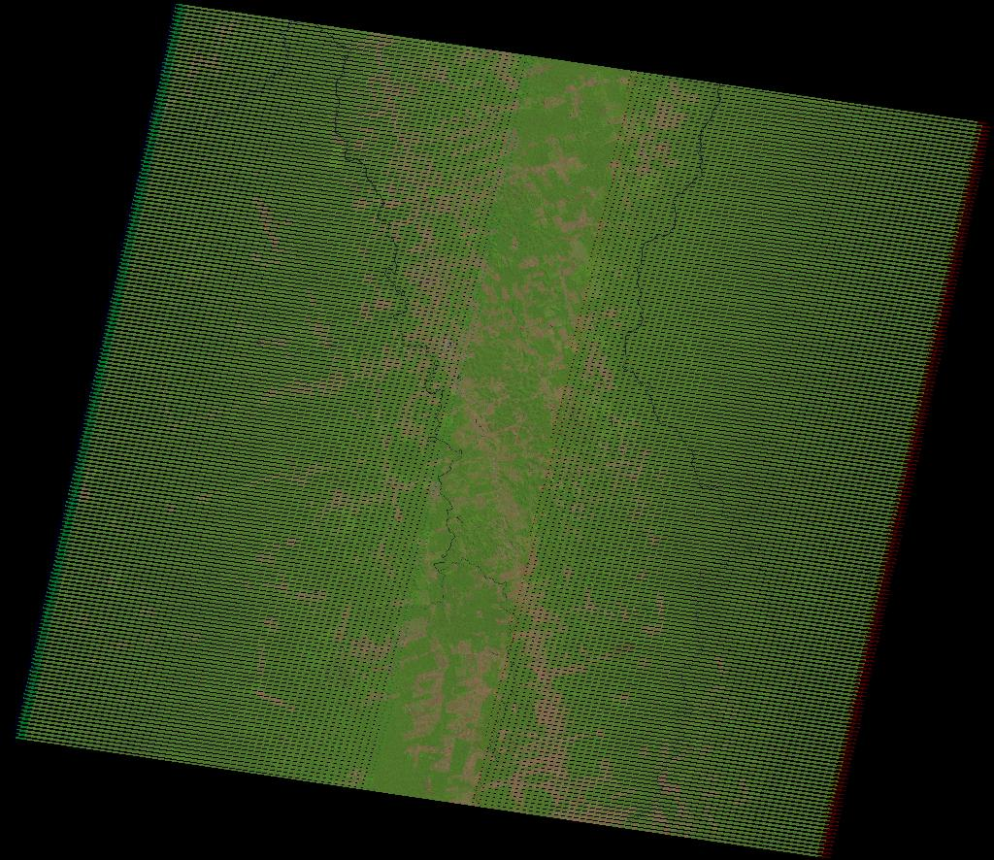
Couldn’t use Landsat 7
(Scan Line Corrector
(SLC) failed in 2003)
Notes:
47473
18566
34120
14840
18789

Slide 22
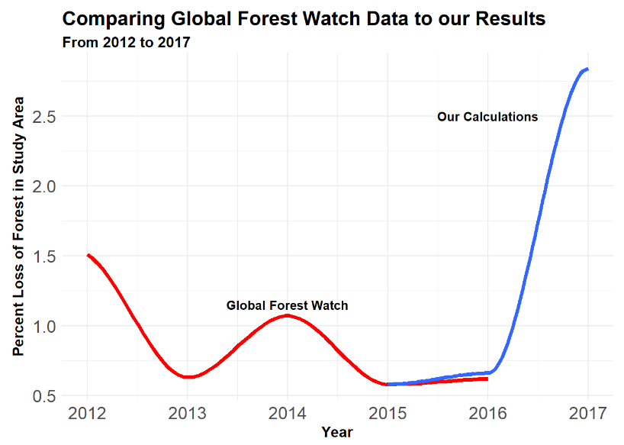

Slide 23

Sources of error
Limited temporal comparison because of Landsat 8’s 2013 start date
Inability to calculate change data for the first year (2013 Landsat composite image)
Discrepancy in year-to-year deforestation estimates between GFW and Earth Explorer (differing beginning and end dates)
Seasonality/harvests
Reprojection into Google Web Mercator
Notes:
Regardless of masking effects

Slide 24
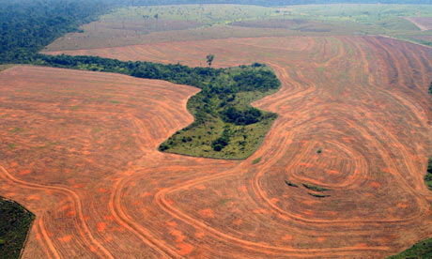
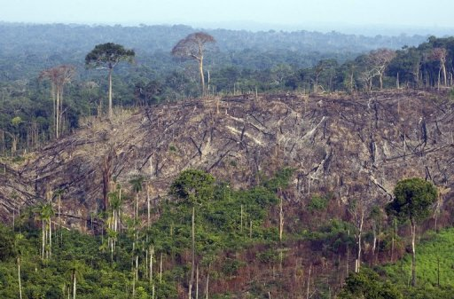
Conclusions
Deforestation rates have increased since political coup
Measurements indicate significant increase; more than by chance
Future research: compare our 2017 calculations to GFW’s 2017 calculations

Slide 25
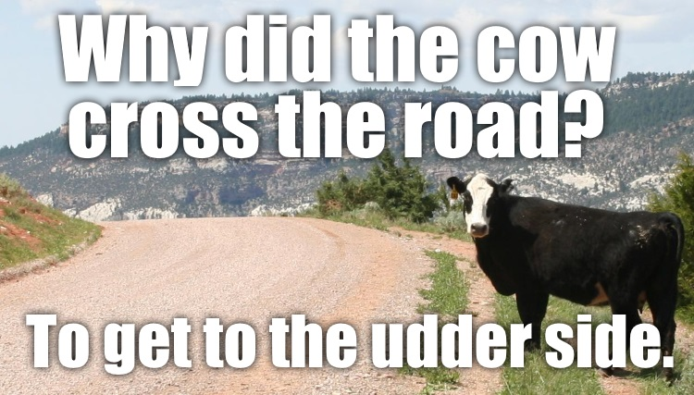

Slide 26


Slide 27
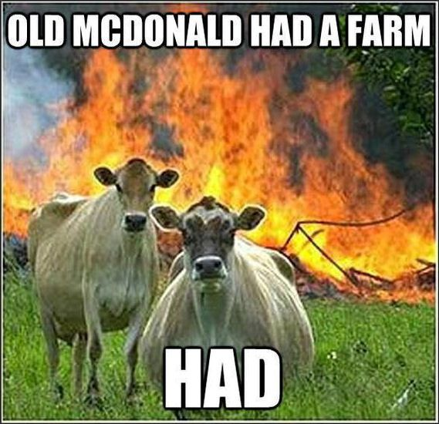

Slide 28
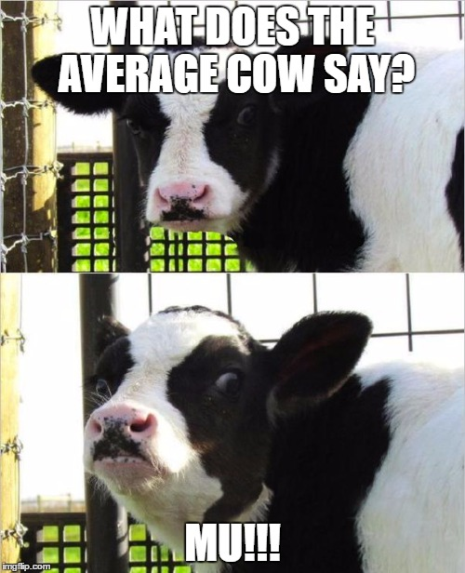

Slide 29


